Slide 1

Epic Java 8
Gardyan Akbar

Slide 2
What we do today
Class Design
Exercises :)))))

Slide 3
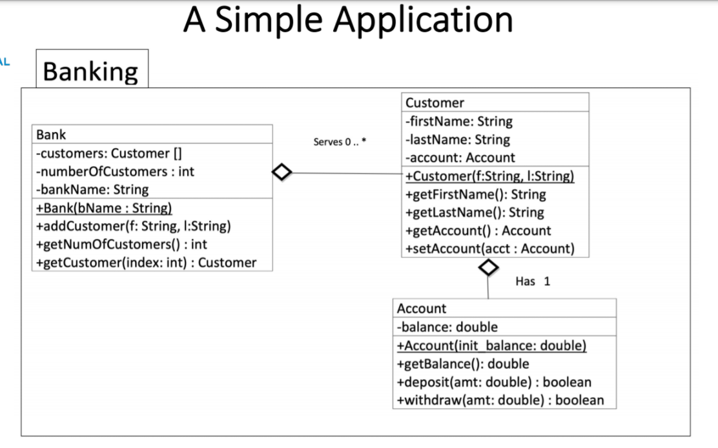
Class Design
What is it?
How you design your classes for your solution
Shows relationships and associations between classes
Terms
Association
Multiplicity
Aggregation
Composition
Inheritance
Realization

Slide 4
Association
A broad terms that just explains that a class has a relationship with another class.
Example:
Bank has an association with Customer (and vice versa)
Customer has an association with Account (and vice versa)

Slide 5
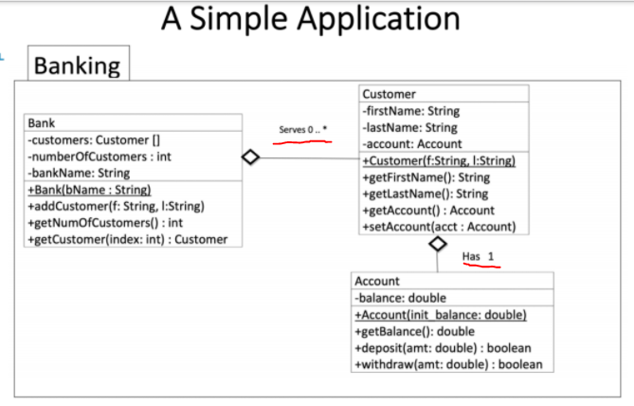
Multiplicity
“Is the active logical association when the cardinality of a class in relation to another is being depicted”
Syntax
Cardinality | Meaning
0..1 | 0 or 1
0..3 | 0 to 3
0..* | 0 to many
1..* | 1 to many

Slide 6
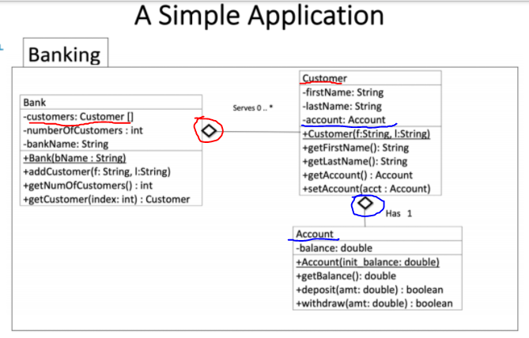
Aggregation
Has-a
whole/part
Contains reference to another class and has ownership to that class

Slide 7
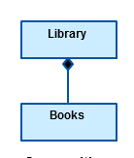
Composition
Similar like aggregation
Shows dependency between classes
When a class cannot exist without another class
Other examples
BusDriver cannot exist without a Bus
A Human depends on a Brain to survive
You cannot get Yanfei without a Wish

Slide 8
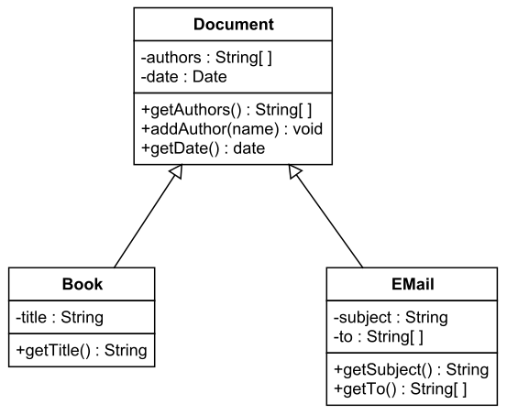
Inheritance
Shows parent-child relationship between classes
Other Examples
Dog class with Animal class
Male and Female class inherits from Human class
JButton and JTable inherits from JComponent class

Slide 9
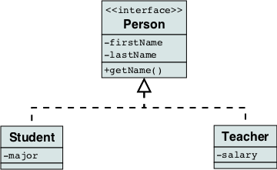
Realization
Shows implementation defined in one class by another class

Slide 10
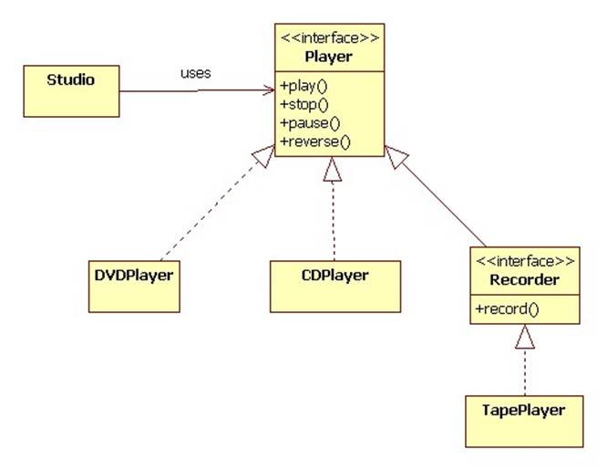
Bonus: Interface

Slide 11
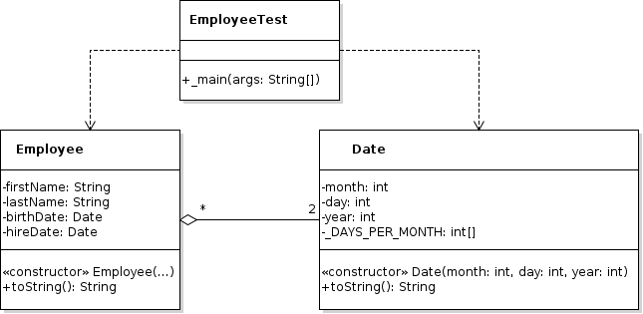
Exercise :)))))
How do you write the cardinality (multiplicity) of:
At least 23
At most 100
Translate the following aggregation into code

Slide 12
Exercise :))))) - Continued
Using an example of Human, Male, and Female classes, create a UML diagram to show their relationship. (Note: Male and Female must inherit from Human class)

Slide 13
Ascended Exercise 1
Create a UML diagram that shows aggregation and composition relationships. Make sure to label the multiplicity.
Rules
Your class relationships must make sense
Name your classes properly
Make sure to have fields and methods (you cannot simply write the name of the class with no content)
Encapsulation does not need to be shown, but if you do use it, use it correctly
Have at the very least 3 different classes

Slide 14
Ascended Exercise 2
Use the UML you created in Ascended Exercise 1 and write the code implementation using Java.

Slide 15
Ascended Exercise 3
Use the UML you created in Ascended Exercise 1 and add an inheritance relationship. You do not need to make the code implementation for this.

